Slide 1




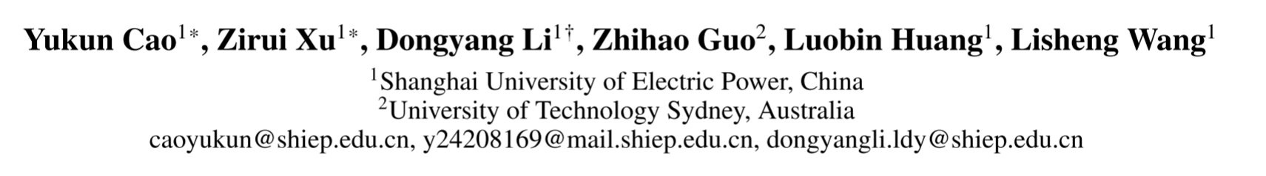





ATAI
Advanced Technique of Artificial Intelligence
ATAI
ChongqingUniversity _{AdvancedTechniqueof}
of Technology Artificial Intelligence
Chongqing University of
Technology
Chongqing University ^{ATAI}
_{of Technology} Advanced Techniqueof
Artificial Intelligence
Chongqing University of Technology
Chongqing University of Technology
DCTR: Dual-Constraint Subgraph Optimization for Knowledge Graph-based Retrieval-Augmented Generation
Code: None
——AAAI 2026
Reported by Xiang Zhang
1

Slide 2
ATAI
Advanced Technique of Artificial Intelligence
ATAI
ChongqingUniversity _{AdvancedTechniqueof}
of Technology Artificial Intelligence
Chongqing University of
Technology
Chongqing University ^{ATAI}
_{of Technology} Advanced Techniqueof
Artificial Intelligence
Chongqing University of Technology
Chongqing University of Technology
Motivation
(1) Conventional KG-RAG approaches are requiring either query decomposition with multiple LLM rounds or parameterized static knowledge injection to update the model. The retrieved subgraphs suffer from incompleteness and semantic drift, and neglect the interaction between subgraph and LLMs in terms of fine-grained structural semantics.
(2) One category involves multi-hop expansion methods such as breadth-first graph traversal after anchoring entities using pre-trained models,which tend to retrieve semantically redundant subgraphs. The other category is lightweight model retrieval based on pseudo-label supervision ,but it uses heuristic supervision such as shortest path, which tends to prioritize structural compactness, thereby sacrificing semantically rich subgraphs. Neither approach accounts for the inherent positional bias of LLMs.

Slide 3
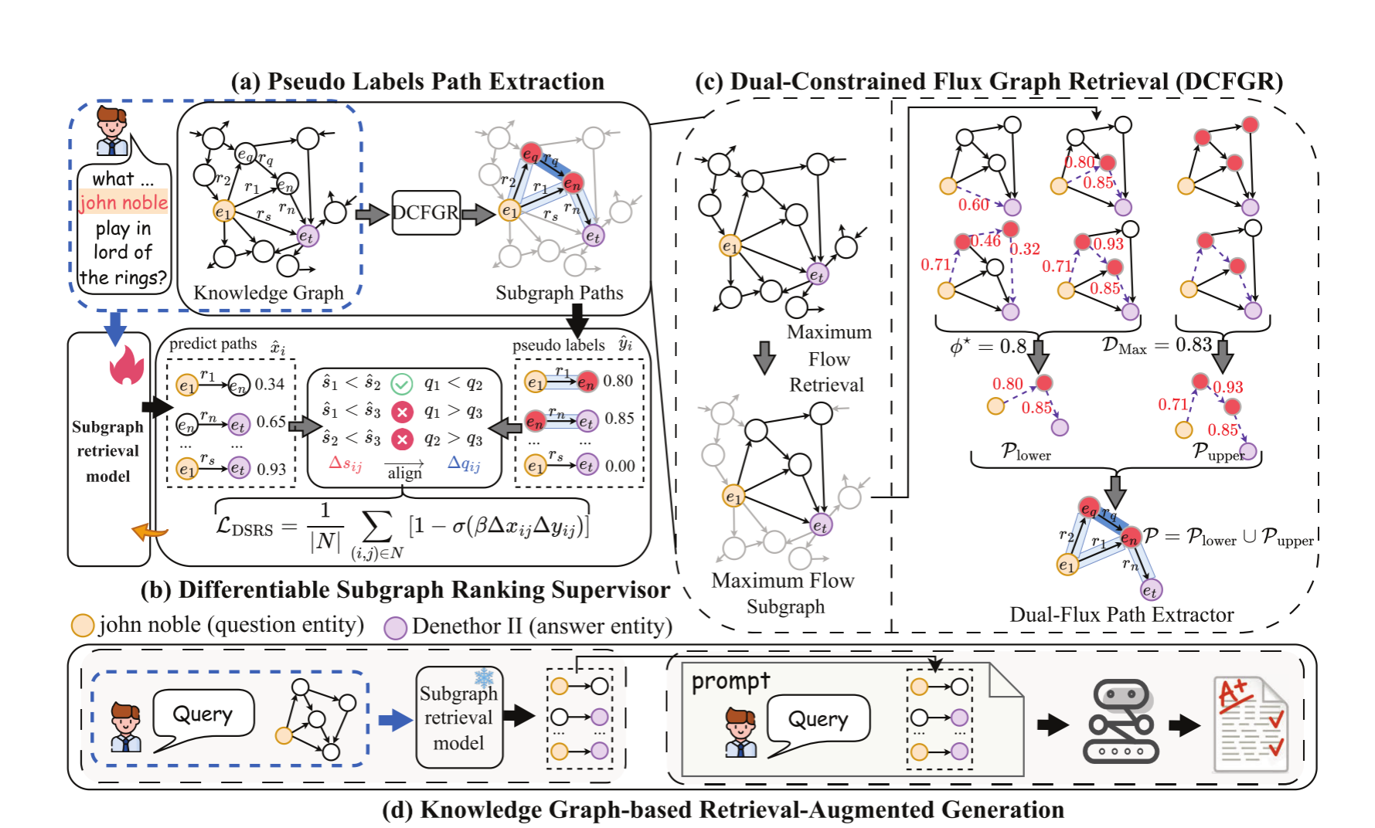
ATAI
Advanced Technique of Artificial Intelligence
ATAI
ChongqingUniversity _{AdvancedTechniqueof}
of Technology Artificial Intelligence
Chongqing University of
Technology
Chongqing University ^{ATAI}
_{of Technology} Advanced Techniqueof
Artificial Intelligence
Chongqing University of Technology
Chongqing University of Technology
Overview

Slide 4
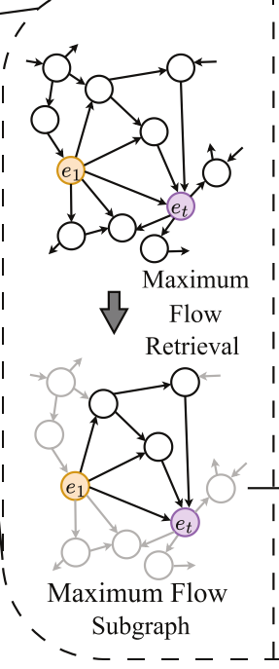
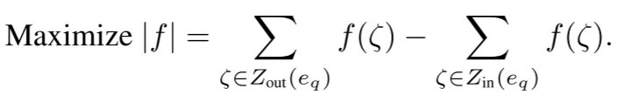
ATAI
Advanced Technique of Artificial Intelligence
ATAI
ChongqingUniversity _{AdvancedTechniqueof}
of Technology Artificial Intelligence
Chongqing University of
Technology
Chongqing University ^{ATAI}
_{of Technology} Advanced Techniqueof
Artificial Intelligence
Chongqing University of Technology
Chongqing University of Technology
Method
First, we identify a globally relevant subgraph Hm, by formulating the extraction task as a maximum flow problem. We construct an information flow network where each triple ζ in the knowledge graph H acts as a directed edge with a capacity equal to its weight w(ζ). The objective is to maximize the total semantic flow, |f|, from a designated source node eq (the query entity) to a sink node ea (the answer entity).

Slide 5
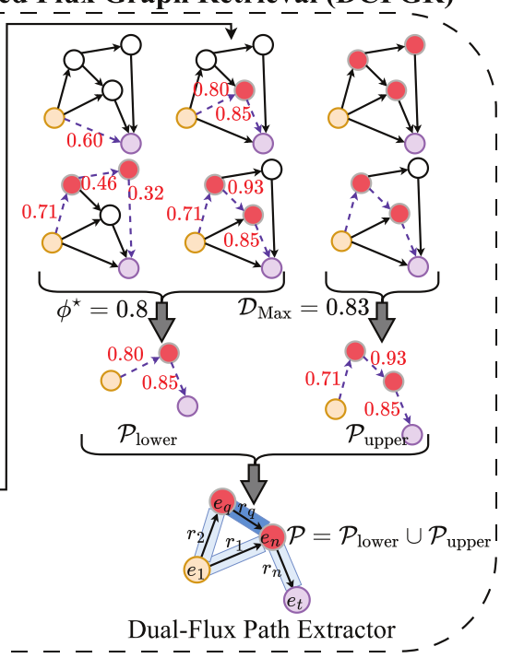

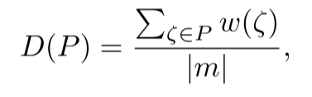




ATAI
Advanced Technique of Artificial Intelligence
ATAI
ChongqingUniversity _{AdvancedTechniqueof}
of Technology Artificial Intelligence
Chongqing University of
Technology
Chongqing University ^{ATAI}
_{of Technology} Advanced Techniqueof
Artificial Intelligence
Chongqing University of Technology
Chongqing University of Technology
Method

Slide 6
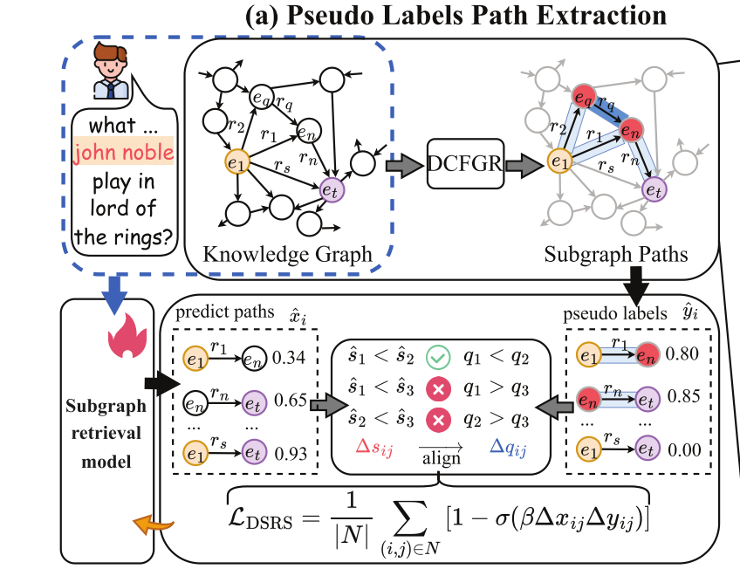
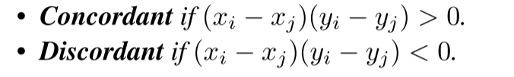
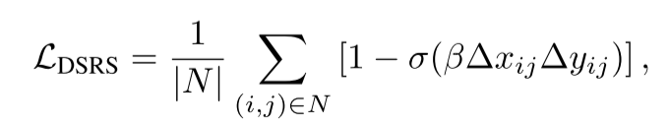

ATAI
Advanced Technique of Artificial Intelligence
ATAI
ChongqingUniversity _{AdvancedTechniqueof}
of Technology Artificial Intelligence
Chongqing University of
Technology
Chongqing University ^{ATAI}
_{of Technology} Advanced Techniqueof
Artificial Intelligence
Chongqing University of Technology
Chongqing University of Technology
Method

Slide 7
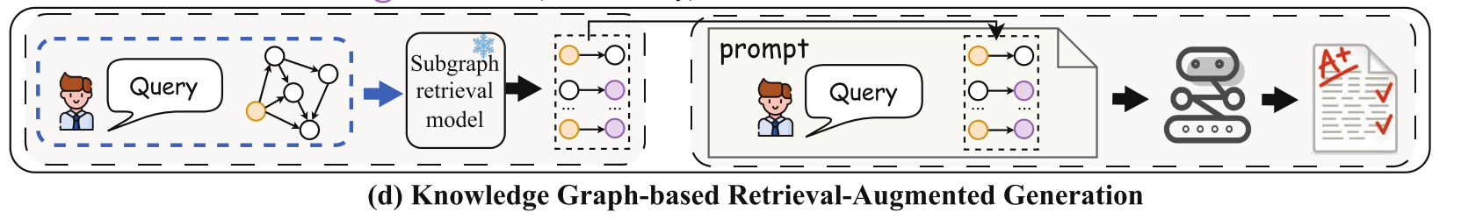
ATAI
Advanced Technique of Artificial Intelligence
ATAI
ChongqingUniversity _{AdvancedTechniqueof}
of Technology Artificial Intelligence
Chongqing University of
Technology
Chongqing University ^{ATAI}
_{of Technology} Advanced Techniqueof
Artificial Intelligence
Chongqing University of Technology
Chongqing University of Technology
Method

Slide 8
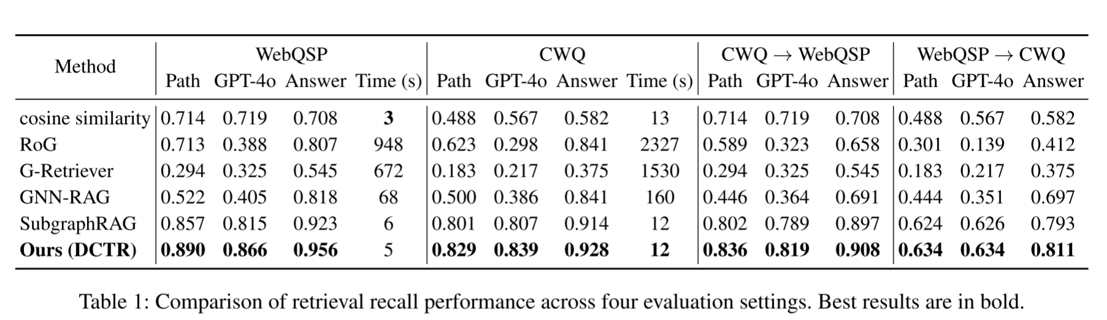
ATAI
Advanced Technique of Artificial Intelligence
ATAI
ChongqingUniversity _{AdvancedTechniqueof}
of Technology Artificial Intelligence
Chongqing University of
Technology
Chongqing University ^{ATAI}
_{of Technology} Advanced Techniqueof
Artificial Intelligence
Chongqing University of Technology
Chongqing University of Technology
Experiments

Slide 9
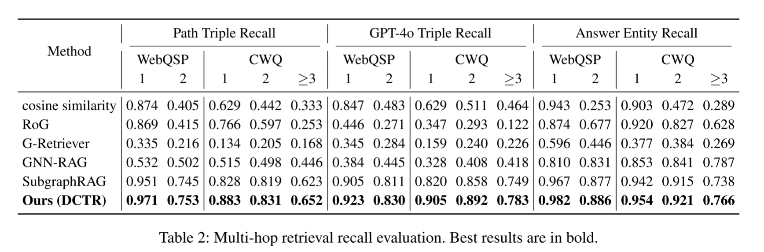
ATAI
Advanced Technique of Artificial Intelligence
ATAI
ChongqingUniversity _{AdvancedTechniqueof}
of Technology Artificial Intelligence
Chongqing University of
Technology
Chongqing University ^{ATAI}
_{of Technology} Advanced Techniqueof
Artificial Intelligence
Chongqing University of Technology
Chongqing University of Technology
Experiments

Slide 10
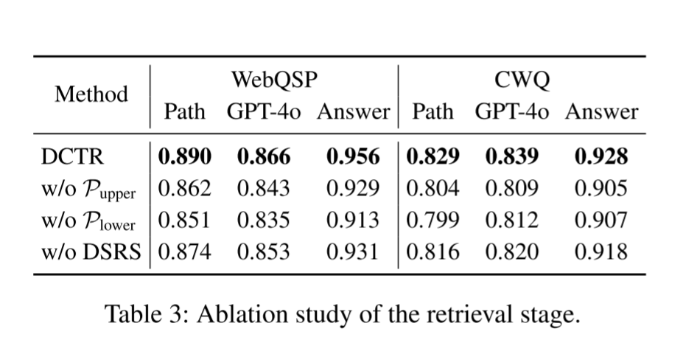
ATAI
Advanced Technique of Artificial Intelligence
ATAI
ChongqingUniversity _{AdvancedTechniqueof}
of Technology Artificial Intelligence
Chongqing University of
Technology
Chongqing University ^{ATAI}
_{of Technology} Advanced Techniqueof
Artificial Intelligence
Chongqing University of Technology
Chongqing University of Technology
Experiments

Slide 11
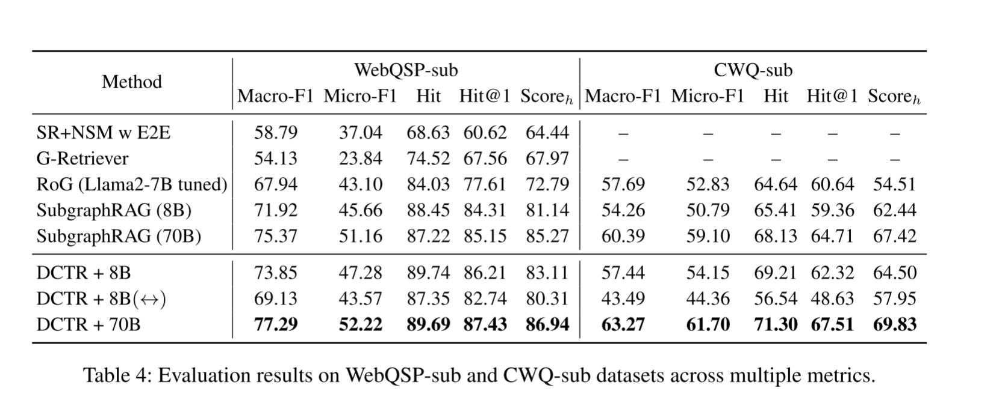
ATAI
Advanced Technique of Artificial Intelligence
ATAI
ChongqingUniversity _{AdvancedTechniqueof}
of Technology Artificial Intelligence
Chongqing University of
Technology
Chongqing University ^{ATAI}
_{of Technology} Advanced Techniqueof
Artificial Intelligence
Chongqing University of Technology
Chongqing University of Technology
Experiments

Slide 12
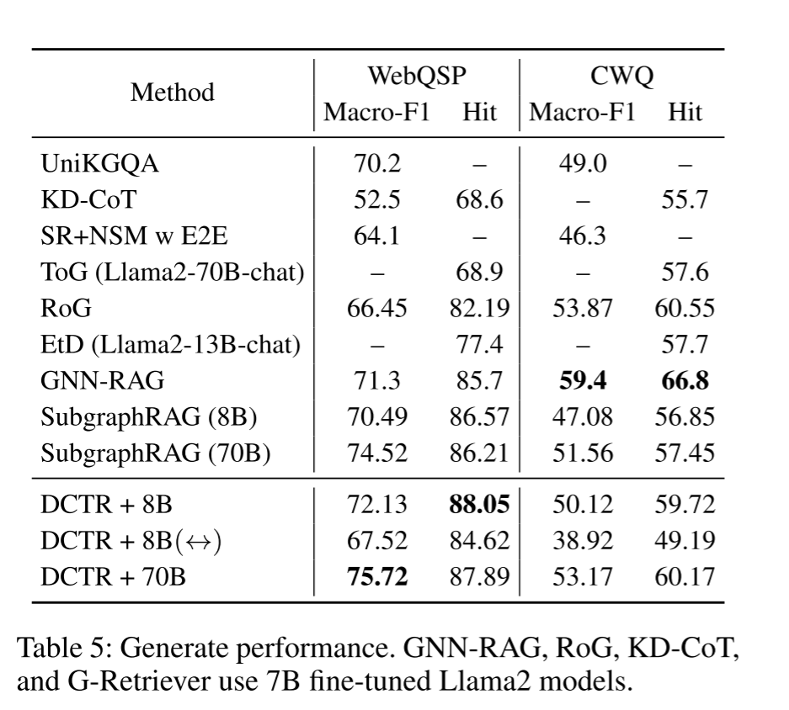
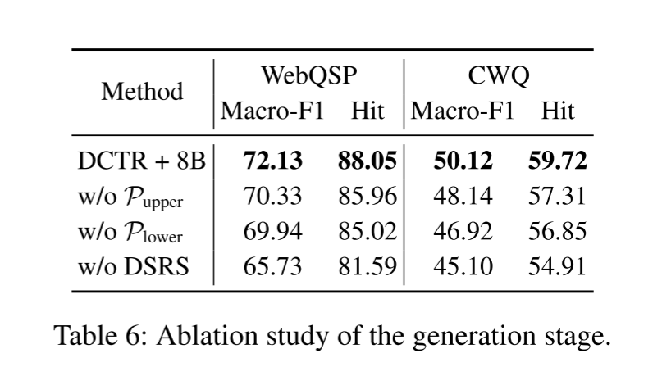
ATAI
Advanced Technique of Artificial Intelligence
ATAI
ChongqingUniversity _{AdvancedTechniqueof}
of Technology Artificial Intelligence
Chongqing University of
Technology
Chongqing University ^{ATAI}
_{of Technology} Advanced Techniqueof
Artificial Intelligence
Chongqing University of Technology
Chongqing University of Technology
Experiments

Slide 13


ATAI
Advanced Technique of Artificial Intelligence
ATAI
ChongqingUniversity _{AdvancedTechniqueof}
of Technology Artificial Intelligence
Chongqing University of
Technology
Chongqing University ^{ATAI}
_{of Technology} Advanced Techniqueof
Artificial Intelligence
Chongqing University of Technology
Chongqing University of Technology
Thanks!

